Slide 1
Security Attacks
Network Security

Slide 2
Security Attacks
Objectives of the Topic
After completing this topic, a student will be able to
describe the security attacks.

Slide 3
Security Attacks
Figures and material in this topic have been
adapted from “Network Security Essentials: Applications and Standards”, 2014, by William Stallings.

Slide 4
Security Attacks
According to the OSI Architecture X.800, security attacks can be classified in two categories:
passive attacks, and
active attacks

Slide 5
Security Attacks
A passive attack attempts to learn or make use of information from the system but does not affect system resources.
An active attack attempts to alter system resources or affect their operation.

Slide 6
Security Attacks
Passive Attacks:
Passive attacks are in the nature of eavesdropping on, or monitoring of, transmissions.
The goal of the opponent is to obtain information that is being transmitted.

Slide 7
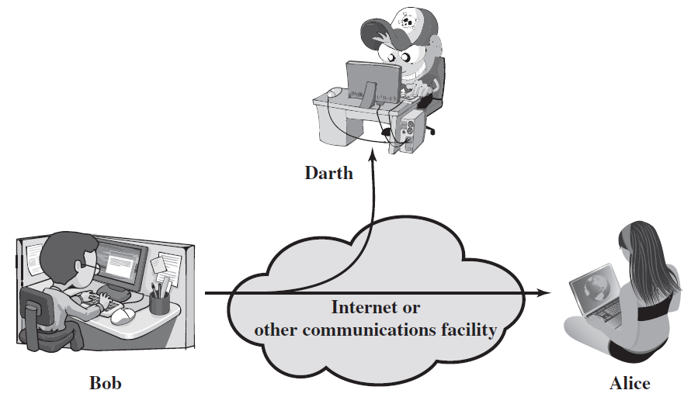
Security Attacks
Passive Attack

Slide 8
Security Attacks
There are two types of passive attacks
release of message contents, and
traffic analysis.

Slide 9
Security Attacks
Release of message contents:
A telephone conversation, an e-mail message, and a transferred file may contain confidential info. Prevent an opponent from learning contents of these transmissions.

Slide 10
Security Attacks
Traffic Analysis:
Even if contents of messages are encrypted, an opponent might still be able to observe the pattern of these messages.

Slide 11
Security Attacks
He could determine the location and identity of communicating hosts and could observe the frequency and length of messages being exchanged.
He can guess the nature of the communication.

Slide 12
Security Attacks
Passive attacks do not alter the data.
Neither the sender nor receiver is aware that a third party has observed the traffic pattern.
Emphasis is on prevention rather than detection.
Use Encryption.

Slide 13
Security Attacks
Active Attacks:
Active attacks involve some modification of the data stream or the creation of a false stream.

Slide 14
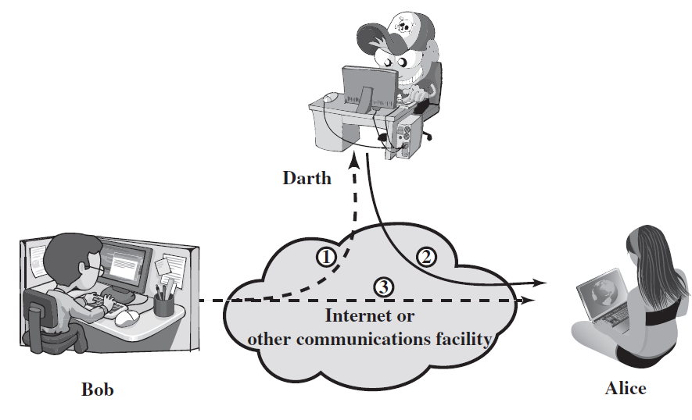
Security Attacks
Active Attack

Slide 15
Security Attacks
Active attacks can be subdivided into four categories:
masquerade,
replay,
modification of messages, and
denial of service.

Slide 16
Security Attacks
Masquerade:
It takes place when one entity pretends to be a different entity.
It usually includes one of the other forms of active attack.

Slide 17
Security Attacks
Replay:
It involves the passive capture of a data unit and its subsequent retransmission to produce an unauthorized effect.

Slide 18
Security Attacks
Modification of messages:
It simply means that some portion of a legitimate message is altered, or that messages are delayed or reordered, to produce an unauthorized effect.

Slide 19
Security Attacks
Denial of Service:
It prevents or inhibits the normal use or management of communications facilities.
E.g. an entity may suppress all messages directed to a particular destination.

Slide 20
Security Attacks
Active Attacks are difficult to prevent because of the wide variety of potential physical, software, and network vulnerabilities.
Goal is to detect attacks and to recover from any disruption or delays caused by them.
End

